Slide 1
Security Risk Analysis

Slide 2
Security Risk Analysis
Guidelines
Security risk analysis, otherwise known as risk assessment, is fundamental to the security of any organization. It is essential in ensuring that controls and expenditure are fully commensurate with the risks to which the organization is exposed.
However, many conventional methods for performing security risk analysis are becoming more and more untenable in terms of usability, flexibility, and critically... in terms of what they produce for the user.
Ahmed Alkhamaiseh (AABFS) AMMAN

Slide 3
Risk Analysis cont.
Security in any system should be commensurate with its risks. However, the process to determine which security controls are appropriate and cost effective, is quite often a complex and sometimes a subjective matter. One of the prime functions of security risk analysis is to put this process onto a more objective basis.
There are a number of distinct approaches to risk analysis. However, these essentially break down into two types: quantitative and qualitative.
Ahmed Alkhamaiseh (AABFS) AMMAN

Slide 4
1. Quantitative Risk Analysis
This approach employs two fundamental elements; the probability of an event occurring and the likely loss should it occur.
Quantitative risk analysis makes use of a single figure produced from these elements. This is called the 'Annual Loss Expectancy (ALE)' or the 'Estimated Annual Cost (EAC)'. This is calculated for an event by simply multiplying the potential loss by the probability.
It is thus theoretically possible to rank events in order of risk (ALE) and to make decisions based upon this.
Ahmed Alkhamaiseh (AABFS) AMMAN

Slide 5
Quantitative Risk Analysis cont.
The problems with this type of risk analysis are usually associated with the unreliability and inaccuracy of the data. Probability can rarely be precise and can, in some cases, promote complacency. In addition, controls and countermeasures often tackle a number of potential events and the events themselves are frequently interrelated.
Notwithstanding the drawbacks, a number of organizations have successfully adopted quantitative risk analysis.
Ahmed Alkhamaiseh (AABFS) AMMAN

Slide 6
2. Qualitative Risk Analysis
This is by far the most widely used approach to risk analysis. Probability data is not required and only estimated potential loss is used.
Most qualitative risk analysis methodologies make use of a number of interrelated elements:
      THREATS
      VULNERABILITIES
      CONTROLS
Ahmed Alkhamaiseh (AABFS) AMMAN

Slide 7
Qualitative Risk Analysis cont.
THREATS
  These are things that can go wrong or that can 'attack' the system.
  Examples might include fire or fraud. Threats are ever present for every system.
VULNERABILITIES
  These make a system more prone to attack by a threat or make an attack more likely to have some success or impact.
  For example, for fire a vulnerability would be the presence of inflammable materials (e.g. paper).
Ahmed Alkhamaiseh (AABFS) AMMAN

Slide 8
Qualitative Risk Analysis cont.
CONTROLS
  These are the countermeasures for vulnerabilities. There are four types:
    Deterrent controls reduce the likelihood of a deliberate attack
    Preventative controls protect vulnerabilities and make an attack unsuccessful or reduce its impact
    Corrective controls reduce the effect of an attack
    Detective controls discover attacks and trigger preventative or corrective controls.
Ahmed Alkhamaiseh (AABFS) AMMAN

Slide 9
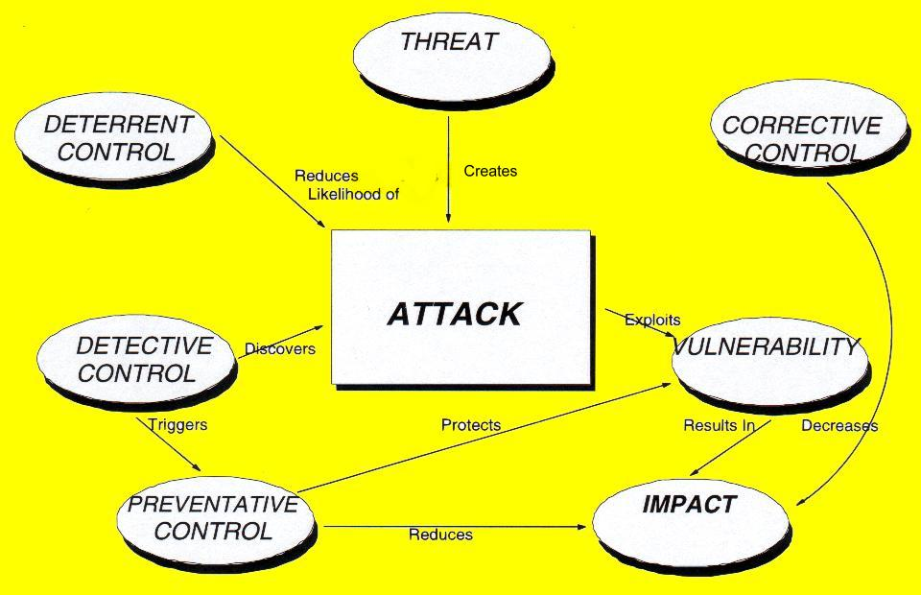
These elements can be illustrated by a simple relational model
Ahmed Alkhamaiseh (AABFS) AMMAN

Slide 10
Risk Assessment
Business Objectives:
FOCUS on key assets
PROTECT against likely threats
PRIORITISE future actions
BALANCE cost with benefits
IDENTIFY / JUSTIFY
Ahmed Alkhamaiseh (AABFS) AMMAN

Slide 11
Risk Assessment … cont.
Positive Factors
Enables security risks to be managed
Maximises cost effectiveness
Safeguards information assets
Enables IT risks to be taken more safely
Ahmed Alkhamaiseh (AABFS) AMMAN

Slide 12
Risks
Unauthorised or accidental disclosure
Unauthorised or accidental modification
Unavailability of facilities / services
Destruction of assets
Ahmed Alkhamaiseh (AABFS) AMMAN

Slide 13
Risk Impact
Monetary losses
Loss of personal privacy
Loss of commercial confidentiality
Legal actions
Public embarrassment
Danger to personal safety
Ahmed Alkhamaiseh (AABFS) AMMAN

Slide 14
Risk Control Strategy
Risk prevention
Reduction of impact
Reduction of likelihood
Early detection
Recovery
Ahmed Alkhamaiseh (AABFS) AMMAN

Slide 15
Risk Assessment
Recap.
Risk Assessment is a business requirement
Risk Assessment is part of overall security management
Can be complex
Methods exist
Approach must suit your organisation
Ahmed Alkhamaiseh (AABFS) AMMAN

Slide 16

Potential Users of Methodology
Project Managers
Systems Developers
Systems Managers
Systems Audit
Business Managers
Security Managers
Ahmed Alkhamaiseh (AABFS) AMMAN

Slide 17

Choosing Methodologies
Assumed expertise of reviewer
Complexity of environment
When to apply Risk Analysis
Consideration of existing controls
Level of detail
Scope
Ahmed Alkhamaiseh (AABFS) AMMAN

Slide 18
The Benefits of:
Security Risk Analysis
Cost Justification
Productivity: Audit/Review Savings
Breaking Barriers - Business Relationships
Self-Analysis
Security Awareness
Targeting Of Security
'Baseline' Security and Policy.
Consistency.
Communication.
Ahmed Alkhamaiseh (AABFS) AMMAN

Slide 19
Cost Justification
Additional security almost always involves additional expense. As this does not directly generate income, it should always be justified in financial terms. The Risk Analysis process should directly and automatically generate such justification for security recommendations in business terms.
Productivity: Audit/Review Savings
A Risk Analysis programmed should enhance the productivity of the security or audit team. By creating a review structure, formalizing a review, security knowledge in the system's "knowledge base" and utilizing "self-analysis" features, much more productive use of time is possible. The ability to 'build-in' expertise should also alleviate the need for expensive external security consultants.
Ahmed Alkhamaiseh (AABFS) AMMAN

Slide 20
Breaking Barriers - Business Relationships
  Security should be addressed at both business management and IT staff.
    Business management are responsible for decisions relating to the security risk/level that the enterprise is willing to accept at a given time.
    IT management are responsible for decisions relating to specific controls and application .
  Risk Analysis should relate security directly to business issues.
Ahmed Alkhamaiseh (AABFS) AMMAN

Slide 21
Self-Analysis
The Risk Assessment system should be simple enough to enable its use without necessitating particular security knowledge, or indeed, IT expertise. This approach enables security to be driven into more areas and to become more devolved. It enables security to become part of the enterprises culture, allowing business unit management to take more of the responsibility for ensuring an adequate and appropriate level of security.
Security Awareness
The widescale application of a risk assessment programmed, by actively involving a range of, and greater number of, staff, will place security on the agenda for discussion and increase security awareness within the enterprise.
Ahmed Alkhamaiseh (AABFS) AMMAN

Slide 22
Targeting Of Security
Security should be properly targeted, and directly related to potential impacts, threats, and existing vulnerabilities. Failure to achieve this could result in excessive or unnecessary expenditure. Risk Analysis promotes far better targeting and facilitates related decisions.
'Baseline' Security and Policy
Many enterprises require adherence to certain 'baseline' standards. This could be for a variety of reasons, such as legislation (eg: Data Protection Act), enterprise policy, regulatory controls, etc. The Risk Analysis methodology should support such requirements and enable rapid identification of any failings.
Ahmed Alkhamaiseh (AABFS) AMMAN

Slide 23
Consistency
A major benefit of the application of Risk Analysis is that it brings a consistent and objective approach to all security reviews. This not only applies across different applications, but different types of business system.
Communication
By obtaining information from different parts of a business unit, a Risk Assessment aids communication and facilitates decision making.
There are also a number of other important, but less tangible, benefits to be accrued via the application of Risk Analysis
Ahmed Alkhamaiseh (AABFS) AMMAN

Slide 24
The End
Ahmed Alkhamaiseh (AABFS) AMMAN

